Slide 1

Exploratory Data Analysis
Gaining Insight Through Data
Preprocessing & Visualization
林成鍇 Julius Ling @ 國立成功大學大數據與AI研究中心

Slide 2
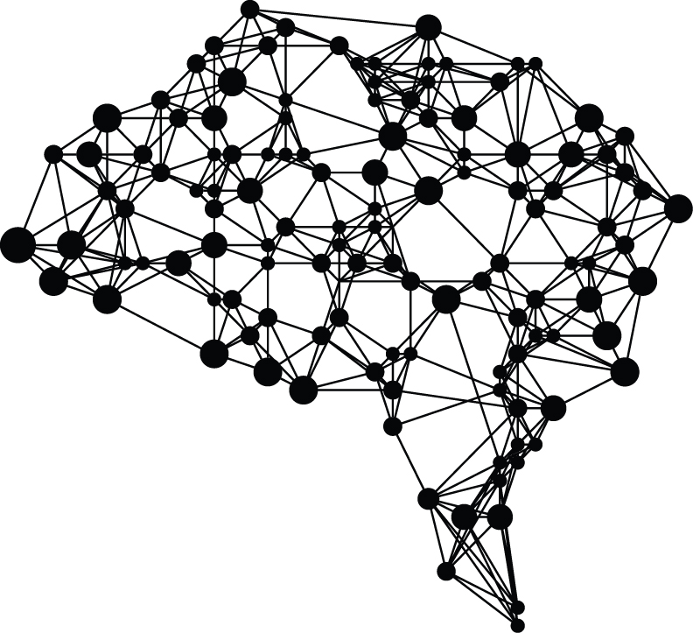
Outline
Data Preprocessing
Visualization

Slide 3
Outline
Data Preprocessing
Visualization

Slide 4

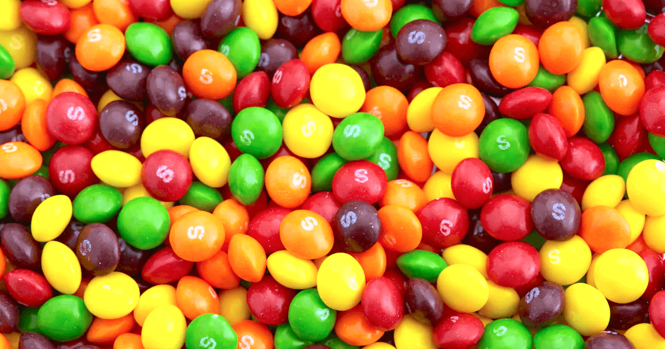
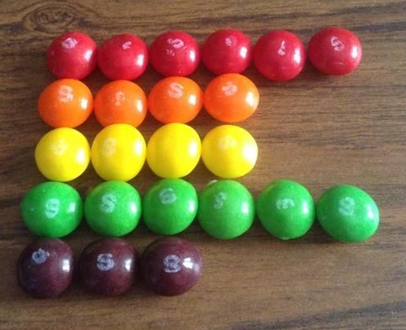
Unstructured, Structured Data &
Feature Engineering

Slide 5

Cleanse your data.

Slide 6
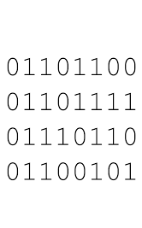
Data Types
Nominal Variable
Quantitative Variable
Images
Time Series
Text
Adapted from Composition with Red Blue and Yellow (1930) by Piet Mondrian

Slide 7
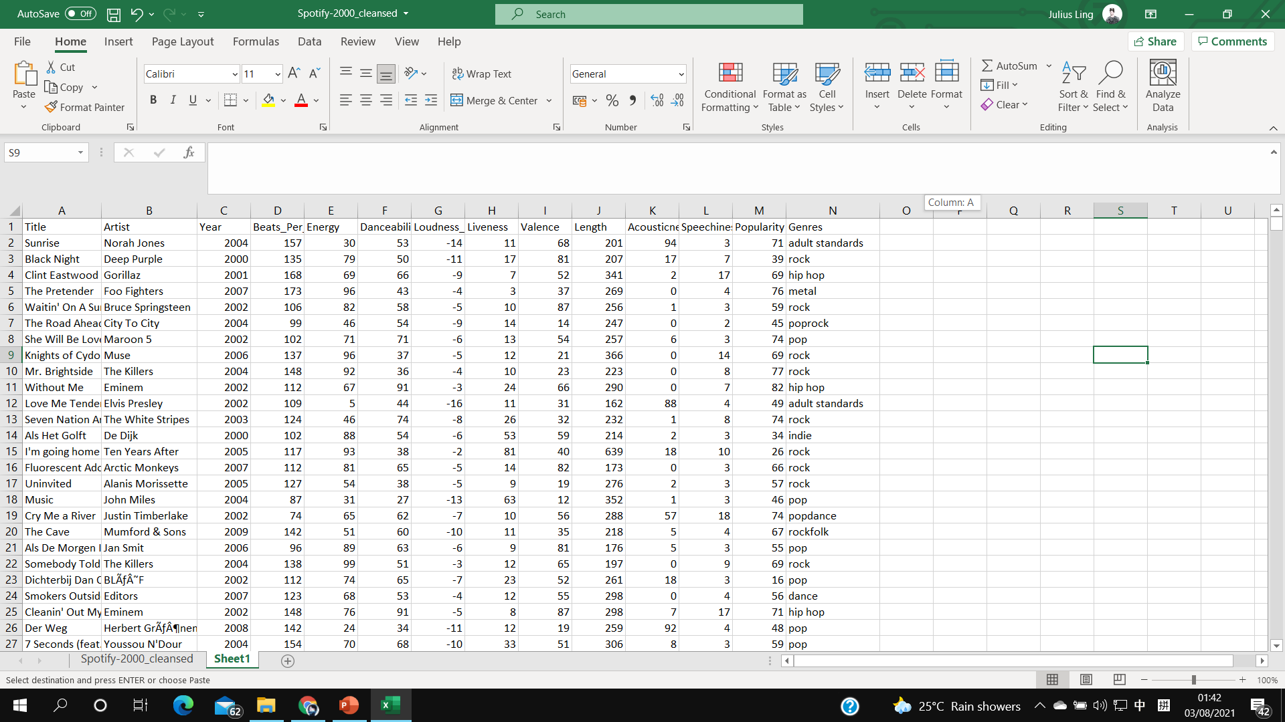
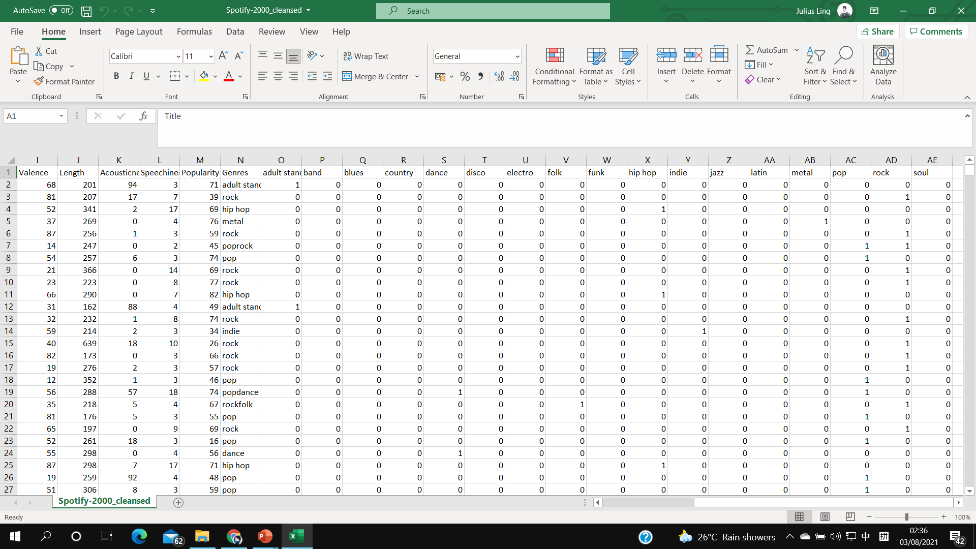
Dummy Coding (a.k.a. One-hot Encoding) of the Nominal Variable

Slide 8
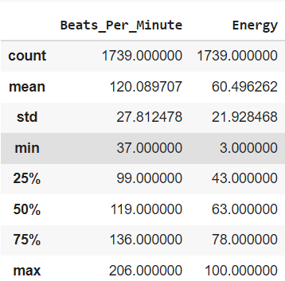
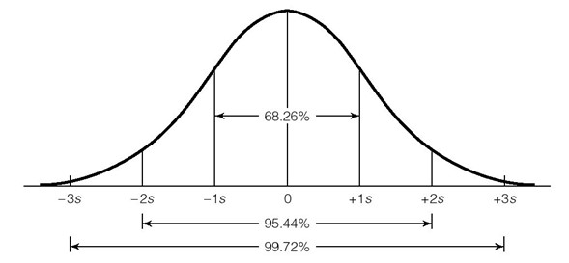
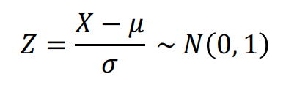
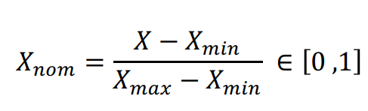
Normalization & Standardization of the Quantitative Data
Standardization 標準化:
μ is the sample mean，
σ is the standard deviation
Normalization 歸一化:

Slide 9
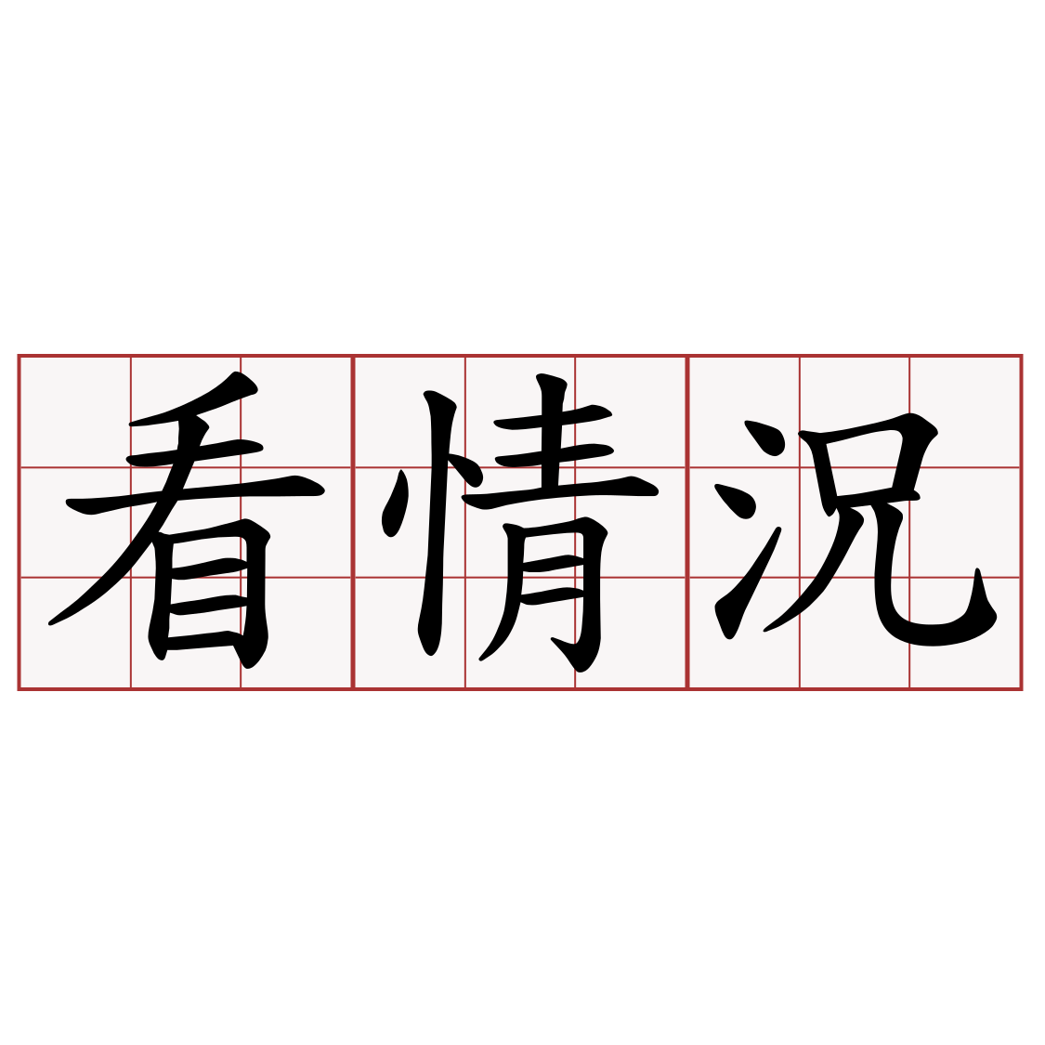
To standardize or to normalize？

Slide 10
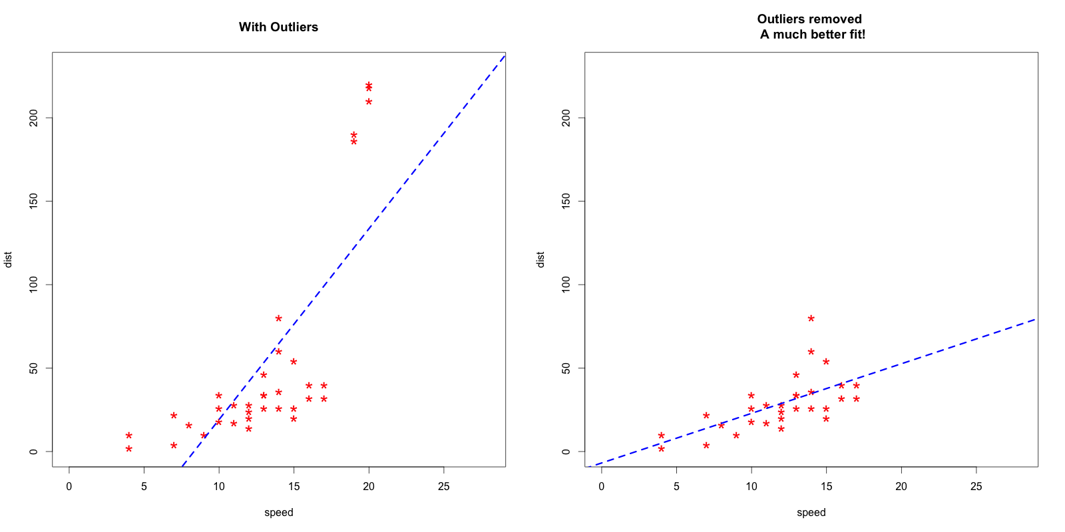
The sample mean and SD are affected under the existence of outliers.

Slide 11
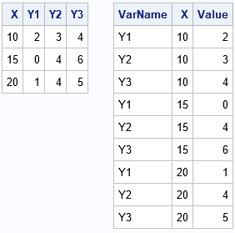
Data Reshape
(from Wide to Long Format)

Slide 12

Missing Data Handling
Null & Missing Data in Python

Slide 13
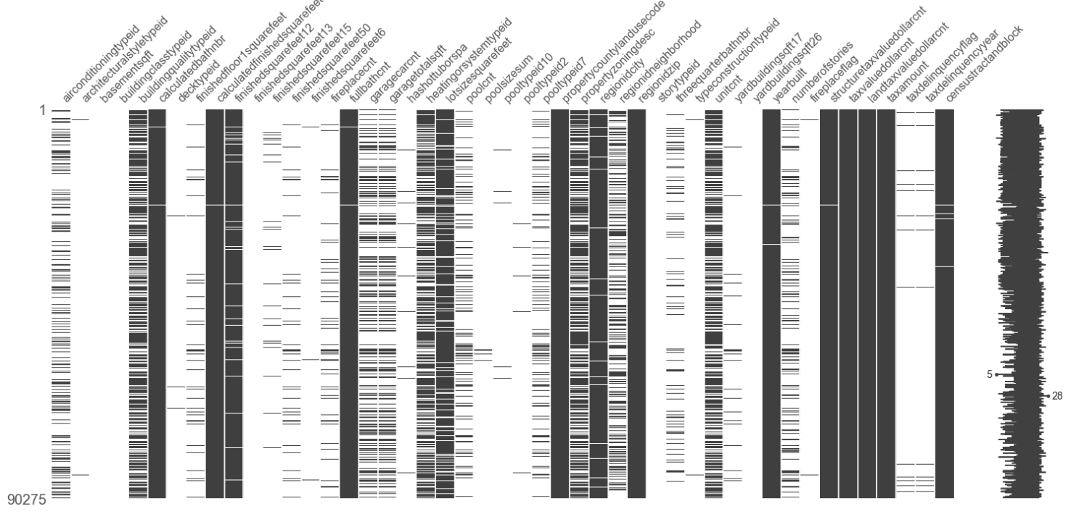
Missing Data Visualization with missingno
Github-missingno

Slide 14
Interpolation / Imputation
Handling Missing Data by Maximum Likelihood"—Paul D. Allison, Statistical Horizons, Haverford, PA, USA

Slide 15
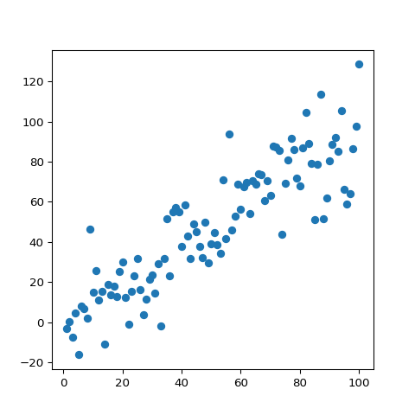
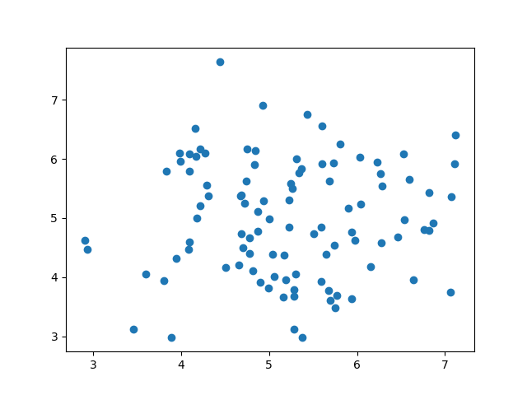
Methods of interpolation
補0（最爛的方法！）
補平均值 或 中位數 或 衆數 （最方便的方法，但是會有統計上的偏差）
補“自己鄰居間的平均值” （要考慮到資料本身的屬性, 實務上以KNN演算法來插補）
從別的資料來源試圖找出真實值（很常時候不實際）
直接把有缺失值的資料刪掉（會有統計上的偏差，而且可能使樣本數目大大減少）

Slide 16
What is the best way to interpolate？

Slide 17
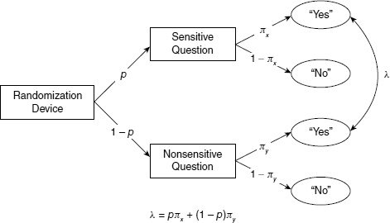
Sensitive Issues Peeping &
Randomized Response Paradigm
How you build up the reassurance

Slide 18
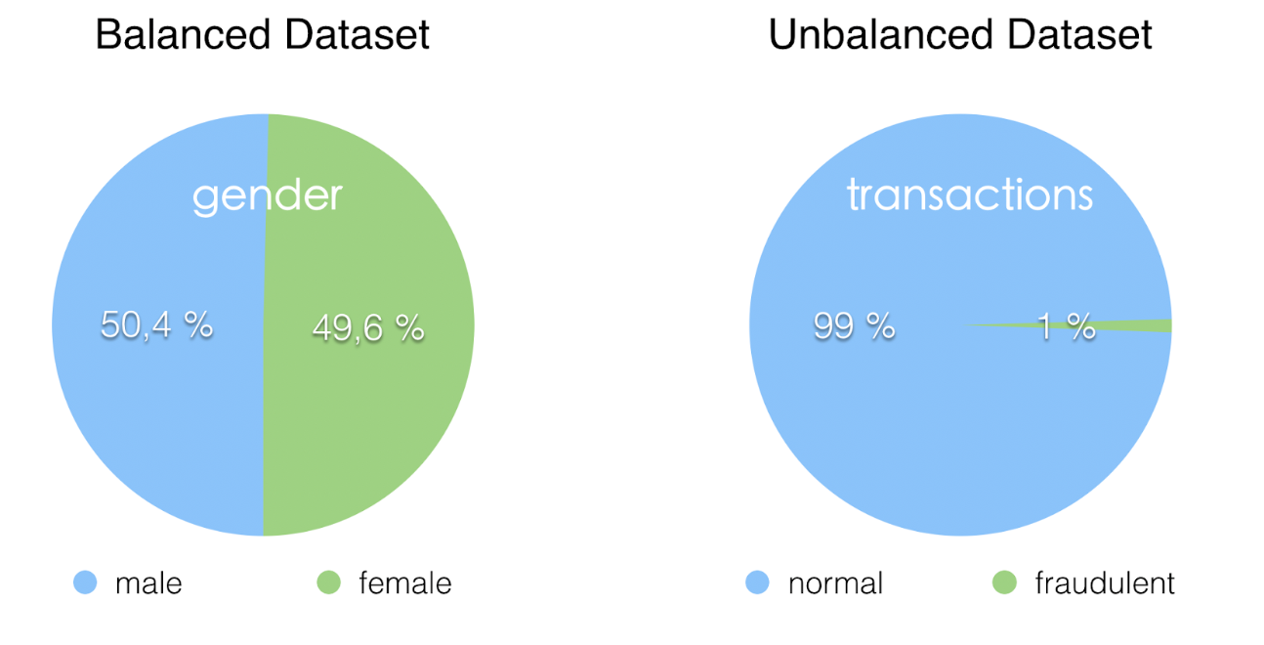
Imbalanced Dataset

Slide 19
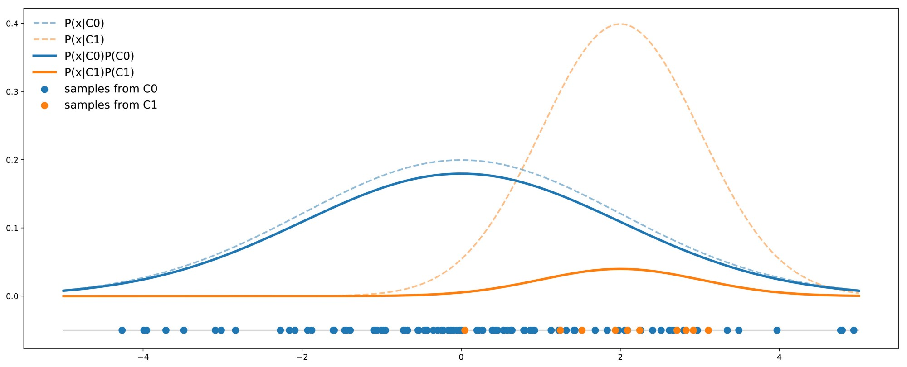
Consequence of the Imbalanced Training
In this example we can see that the curve of the C0 class is always above the curve of the C1 class and, so, for any given point the probability that this point was drawn from class C0 is always greater than the probability it was drawn from class C1. The accuracy of the classifier would be maximal when always answering C0.
Handling imbalanced datasets in machine learning

Slide 20
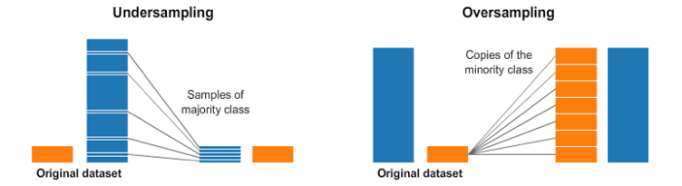
Coping with Imbalanced Dataset

Slide 21
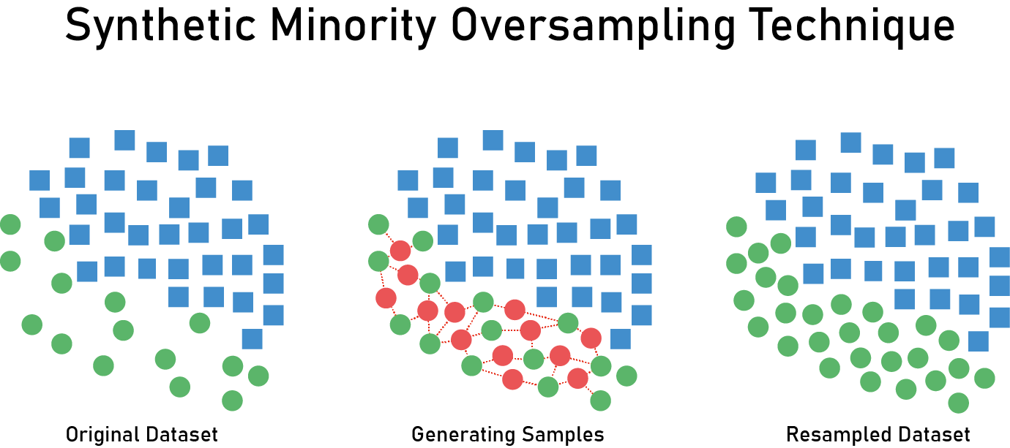
a.k.a SMOTE, as a method to generate balanced dataset synthetically by increasing the cardinality of the minority class(es).

Slide 22
Modifying the dataset with resampling-like methods is changing the reality, it requires careful interpretation of its output.
Reworking on the data is not always a solution, we could reframe the classification problem in another way, in terms of Cost-based Classification.
We are going to touch on this in the future lesson.

Slide 23
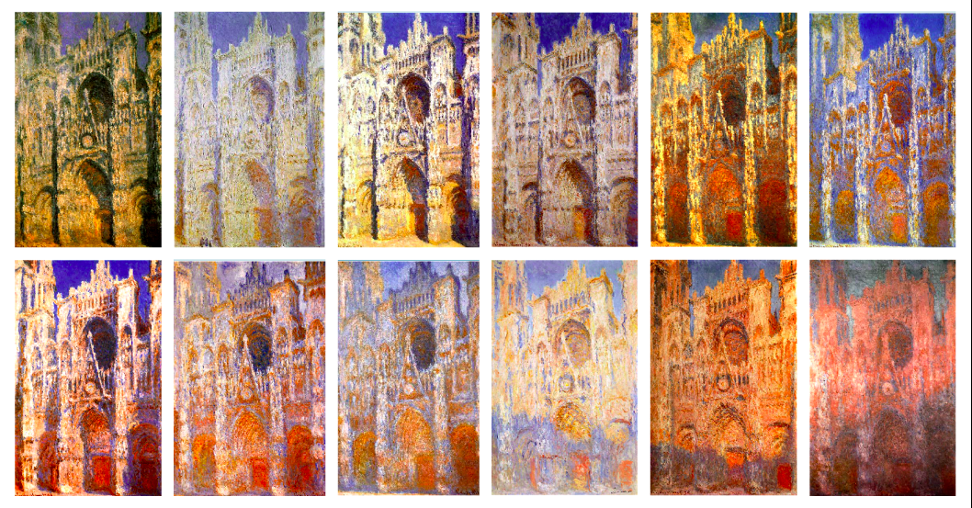
Lesson learnt from Claude Monet’s Rouen Cathedral
Trash in, trash out.

Slide 24
Outline
Data Preprocessing
Visualization

Slide 25
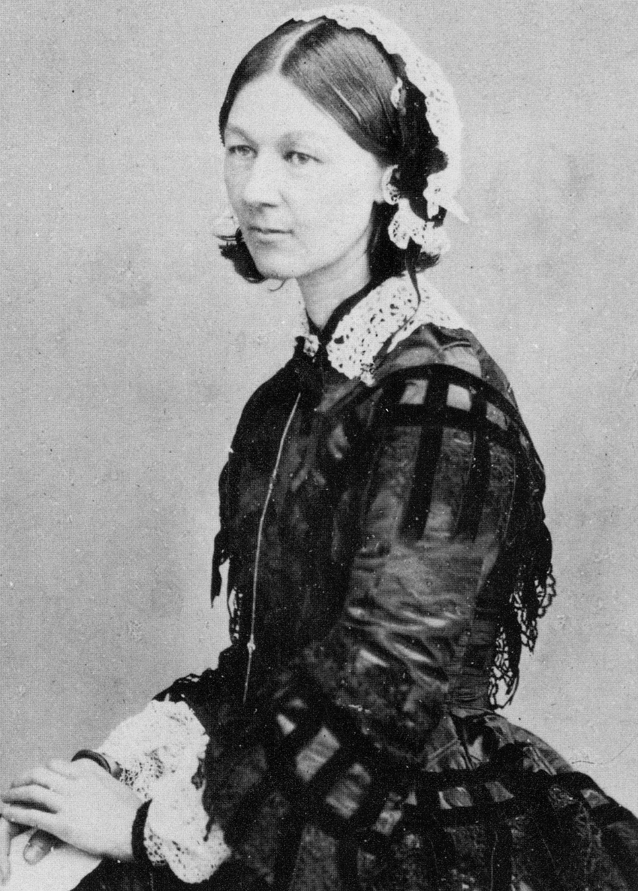
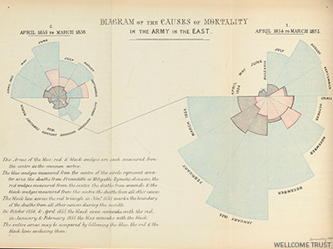
Florence Nightingale

Slide 26
Why visualize?

Slide 27

Anomaly (Outlier) Detection

Slide 28
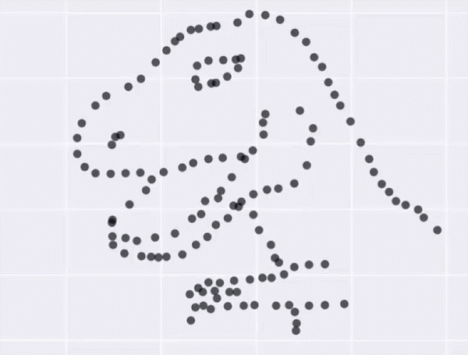
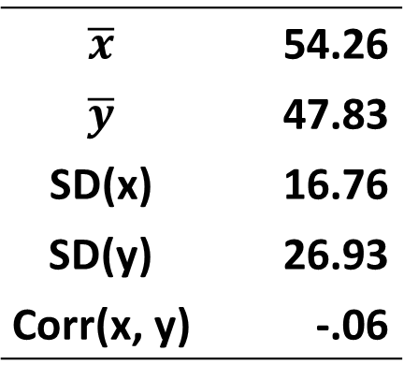
Datasaurus
$\overline{x}$ | 54.26
$\overline{y}$ | 47.83
SD(x) | 16.76
SD(y) | 26.93
Corr(x, y) | -.06
Matejka & Fitzmaurice (2017)

Slide 29
Data visualization provides clear understanding of the patterns in the data in order to detect any hidden structures within the data.
Notes:
Cheung and Jak (2016) 價值不在於大數據本身，而是可以從數據中提取的信息中。

Slide 30
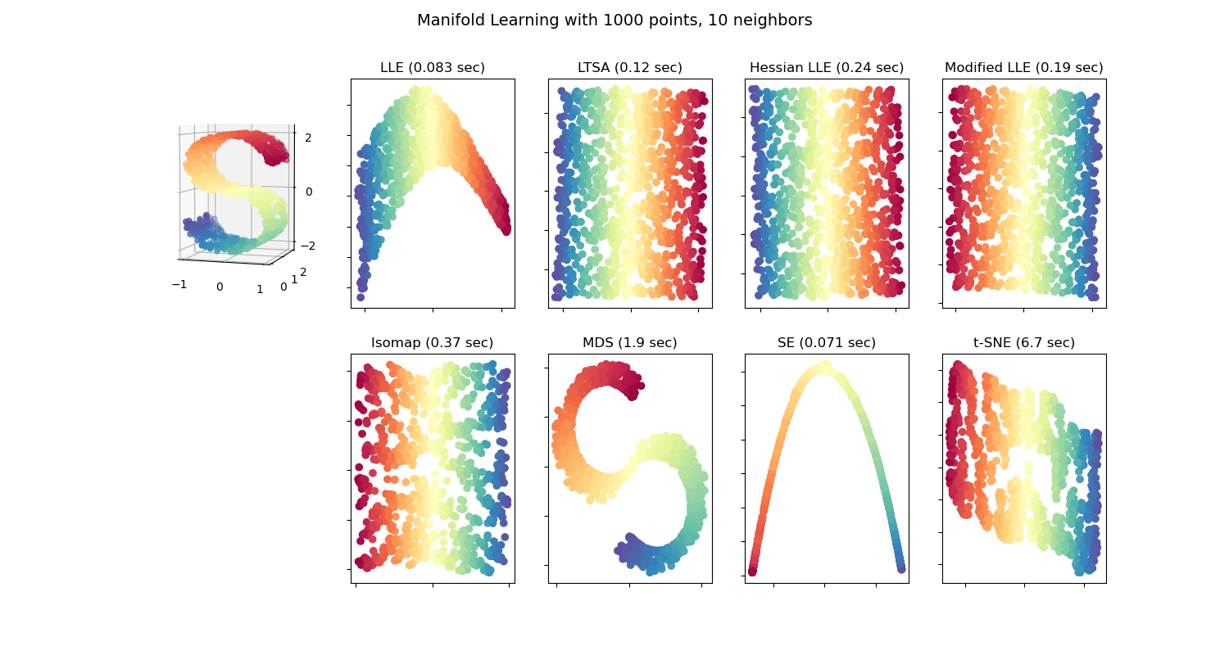
Manifold Learning for Visualization

Slide 31
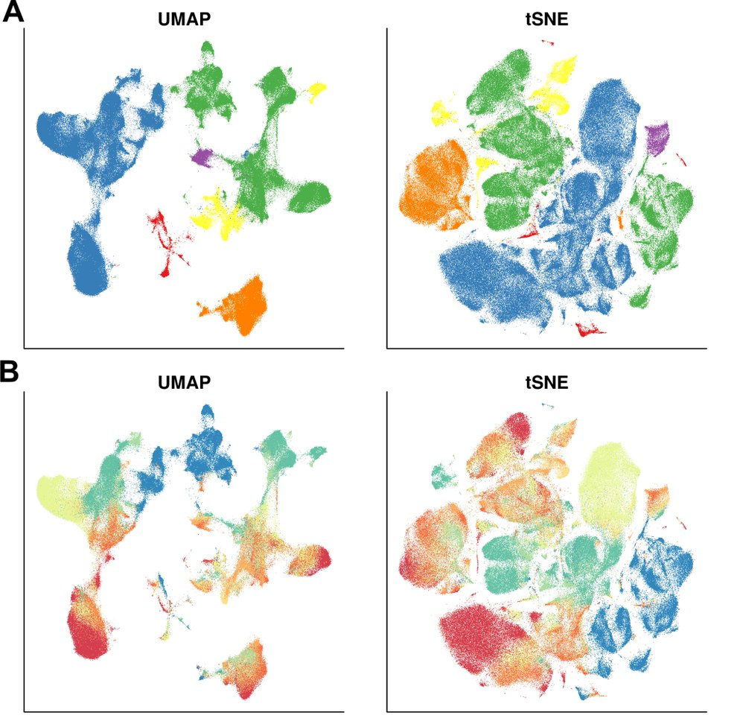

Pablo Picasso, Portrait of Dora Maar, 1937
Dimension Reduction &
Cubism

Slide 32


Visualization with
Matplotlib and Seaborn

Slide 33

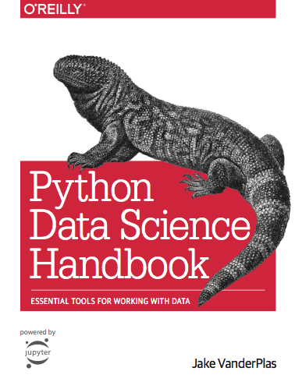

Slide 34

Tutorial of Altair visualization

Slide 35
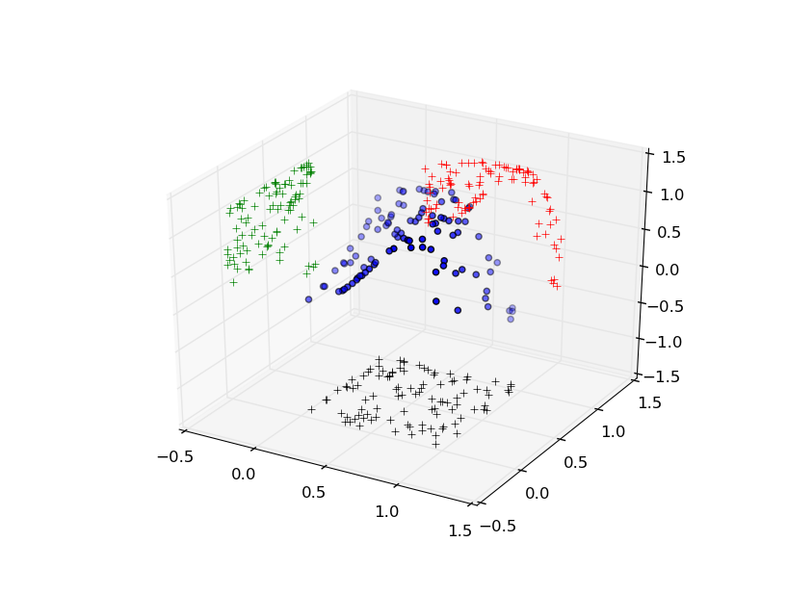
3D-Scatter Plot with Pyplot

Slide 36
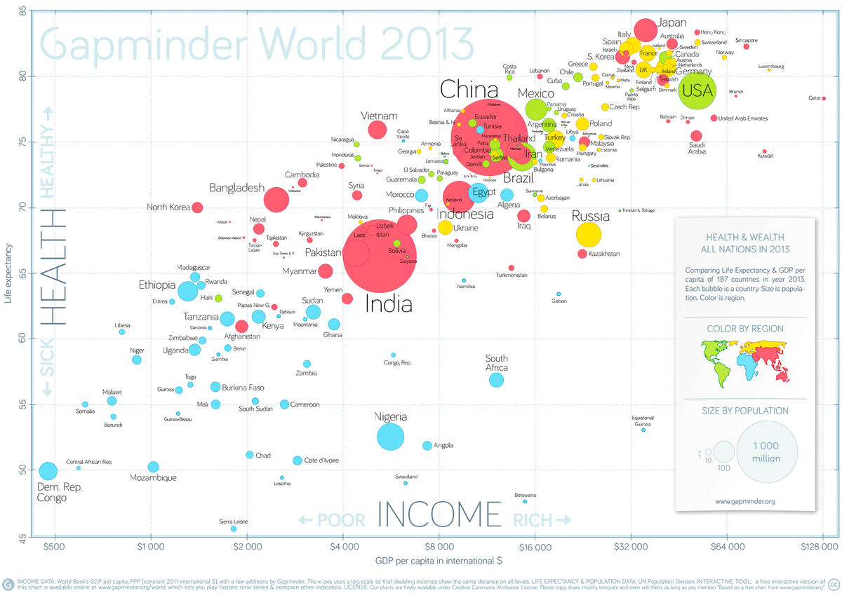
Gapminder Foundation

Slide 37




Slide 38
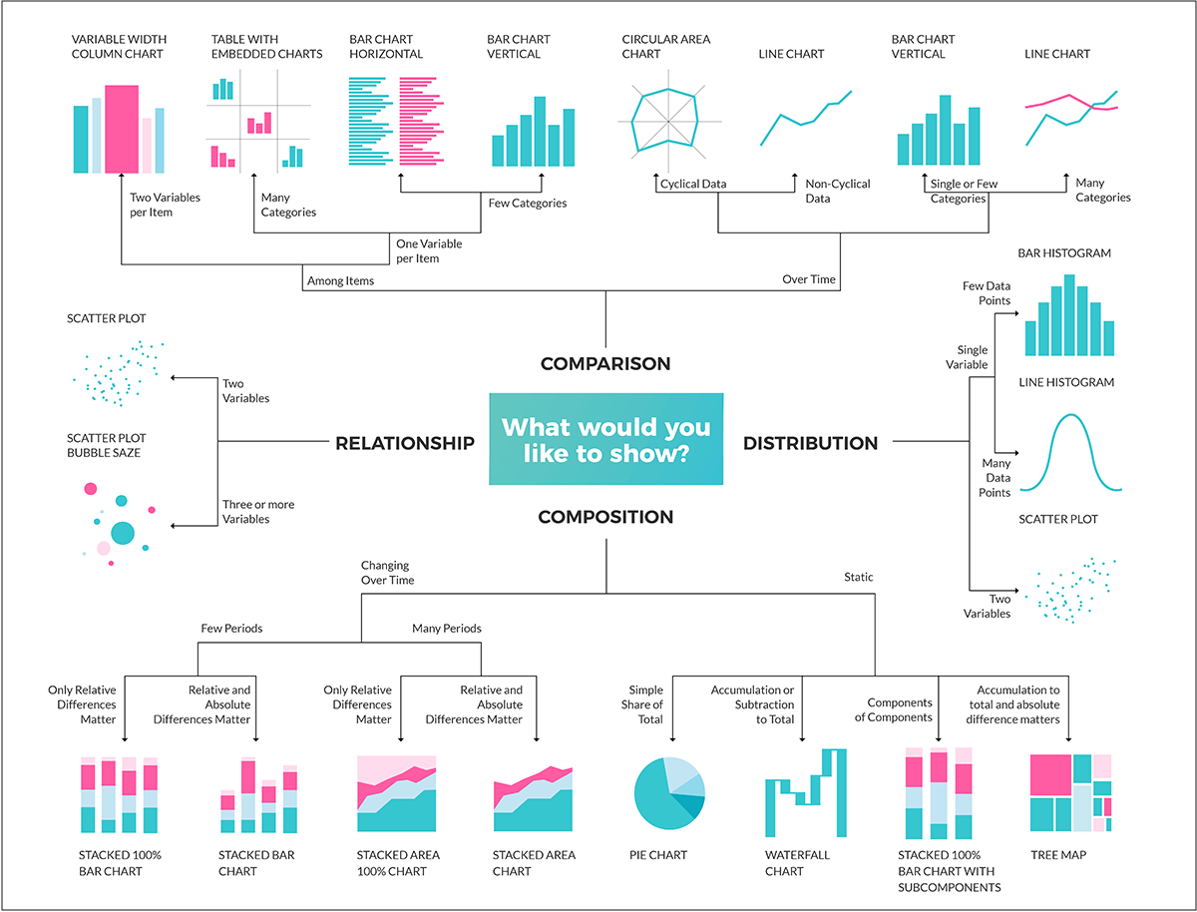
Taxonomy of Visualization Graph

Slide 39

Ridgeline Plot & Pop Culture

Slide 40

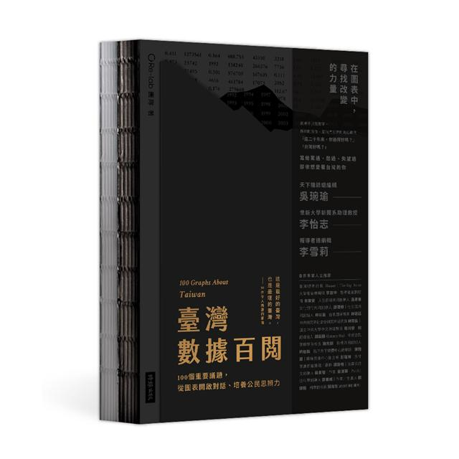

Slide 41
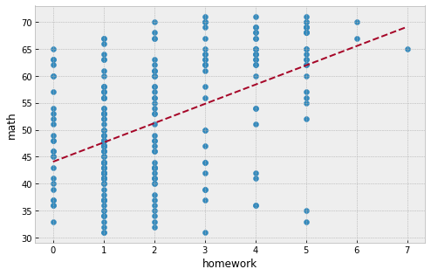

Slide 42
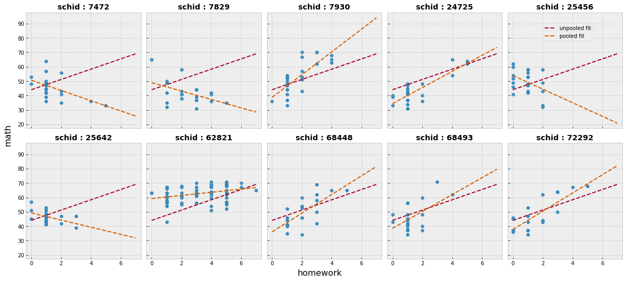
The conclusion would be made different in account of another relevant variable. Here’s a call to visualize with aim.
帶著預期，分析、視覺化資料。

Slide 43

Datavizsociety @ Instagram (Check this out!)

Slide 44
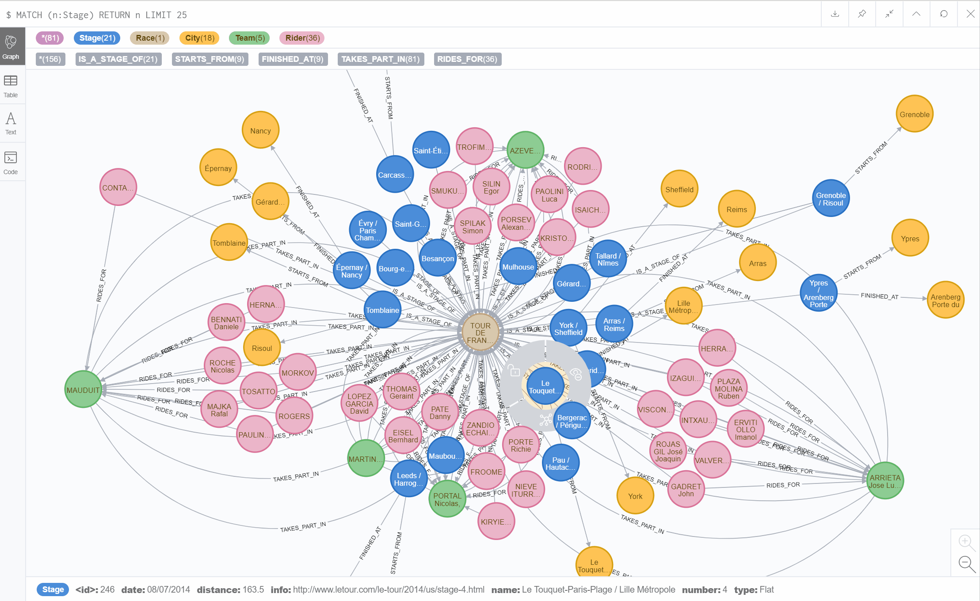
Knowledge Graph & Social Graph Analysis

Slide 45
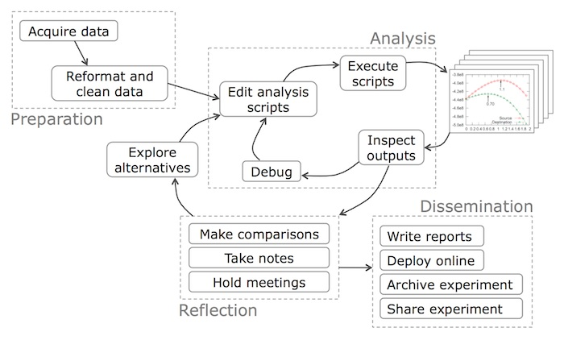
Data Science Workflow

Slide 46
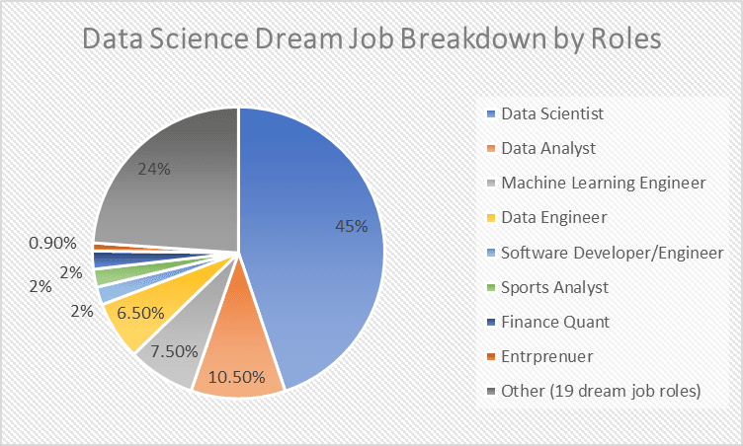

Slide 47


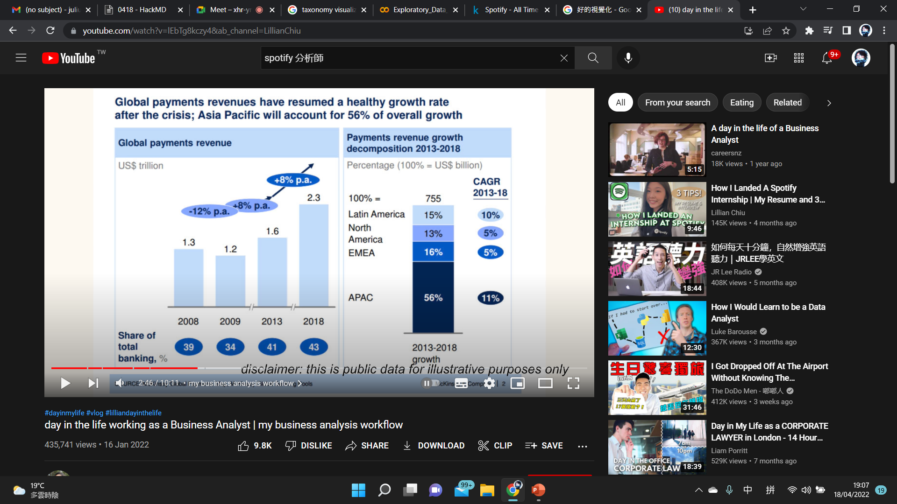

Slide 48
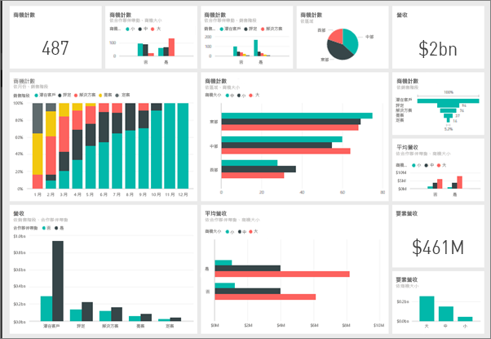
Data Dashboard & Power BI

Slide 49
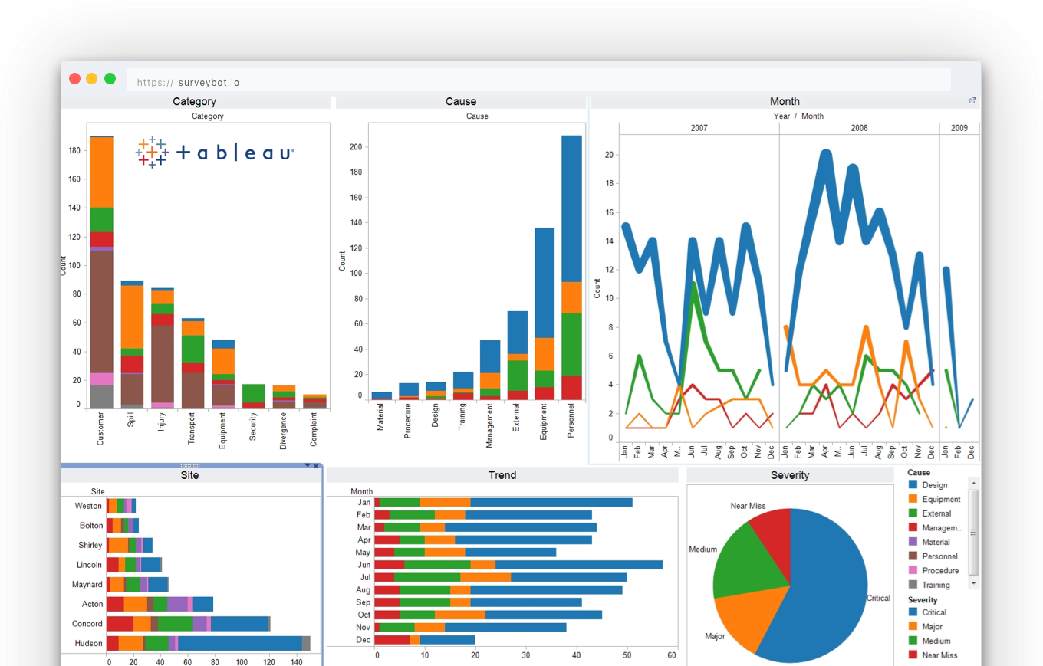
Tableau

Slide 50
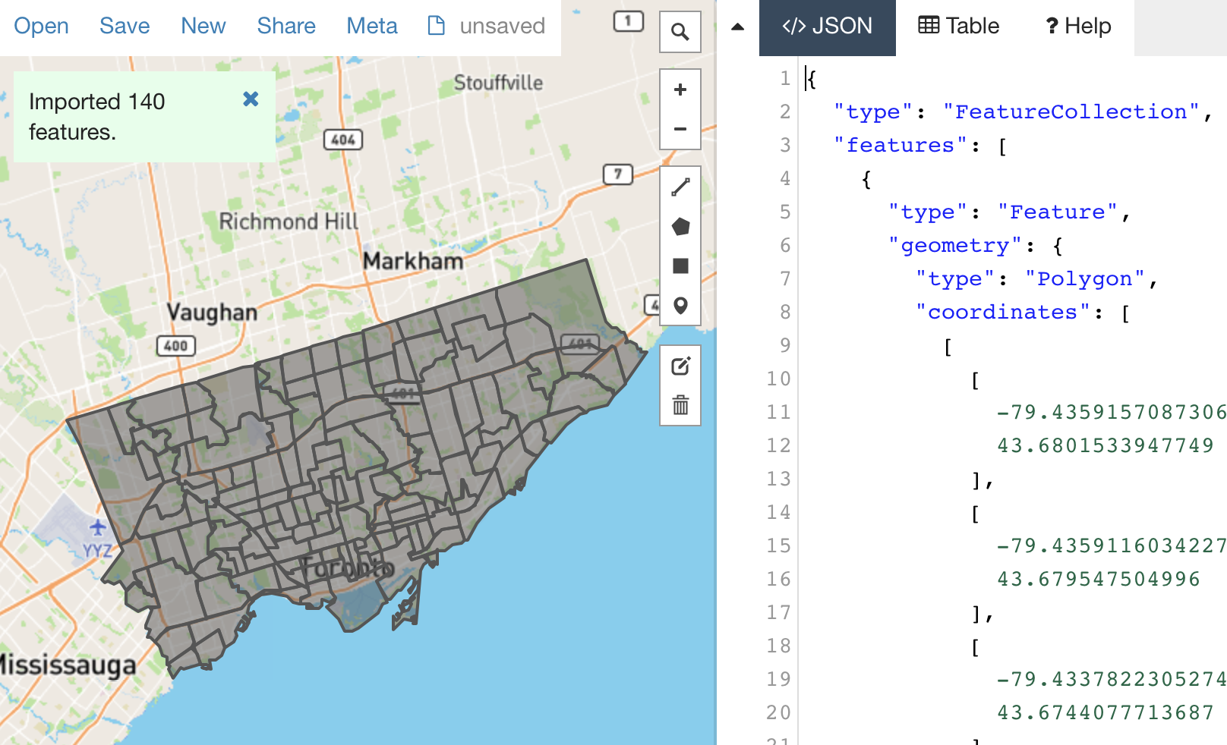
GeoJSON & Geographical Mapping

Slide 51
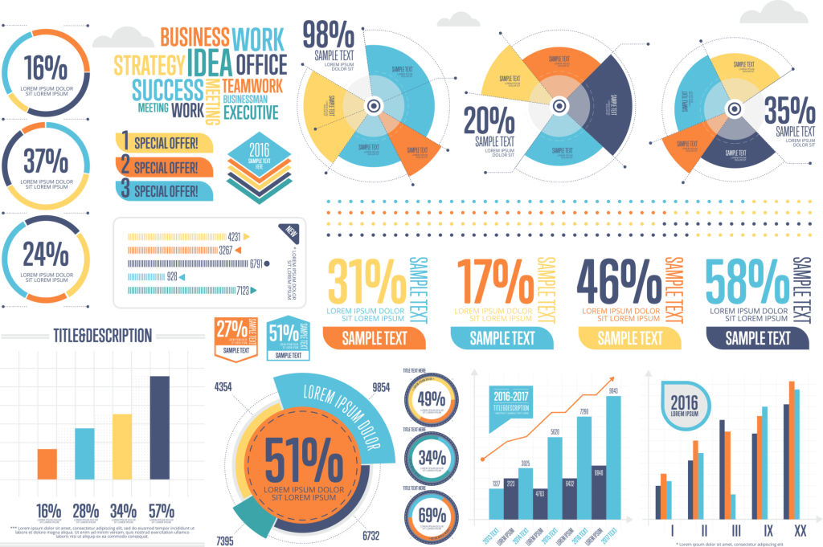
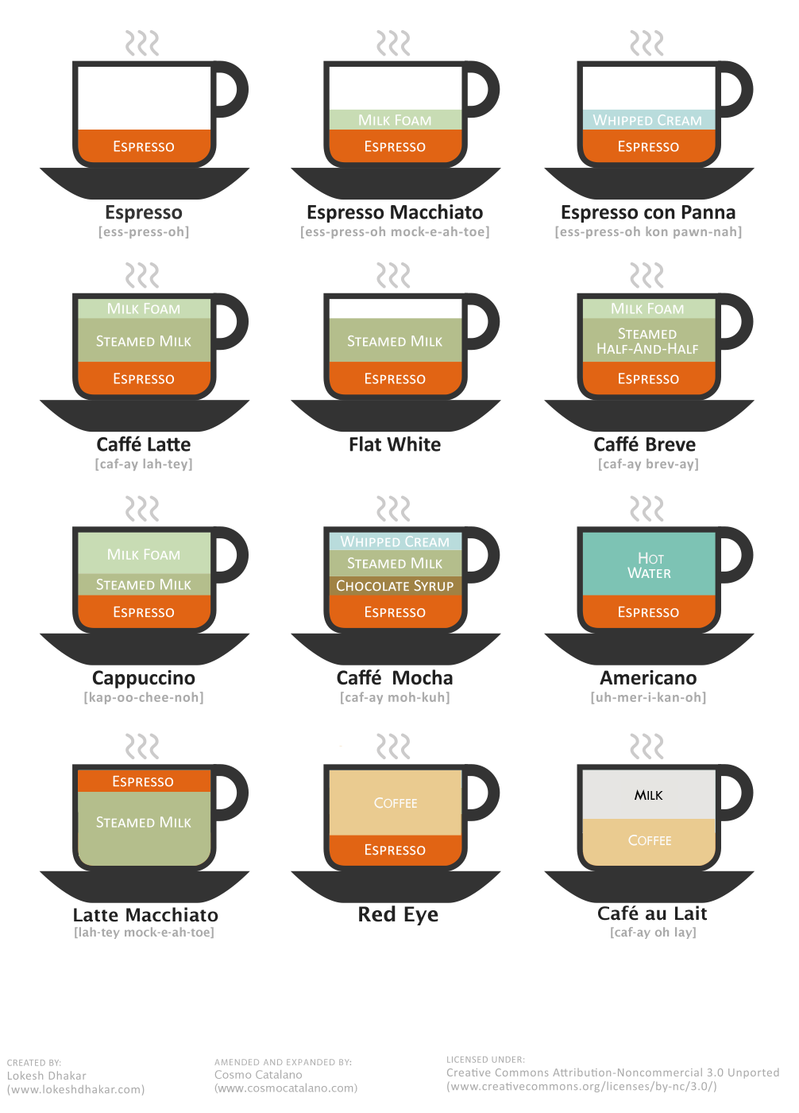

Infographics

Slide 52

Thank You
FOR WATCHING AND LISTENING

